Slide 1
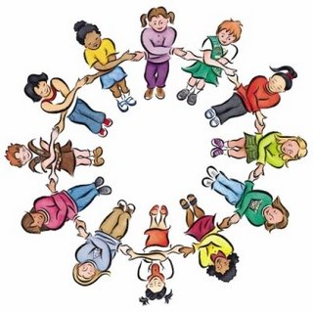
Circle of Friends
Dr Beth Turner
Educational Psychologist

Slide 2

Circle of Friends
The Circle of Friends approach is a method of supporting individual children by harnessing the power of the peer group.
Notes:
‹#›

Slide 3

Circle of Friends ~ misnomer?
The purpose is to elicit understanding in the children and make it more likely that the isolated child will be included and less likely to show behaviours of distress.
It is NOT about the children becoming the child’s friend but making friendly suggestions and being helpful

Slide 4

First steps
Cognitive and emotional skills
Old enough to reflect on their own and other children’s behaviours.
Likely to remember the issues discussed and the strategies discussed.
Parents and the child in question understand the process and have given permission.
Ed Psych/SENCo
Notes:
‹#›

Slide 5
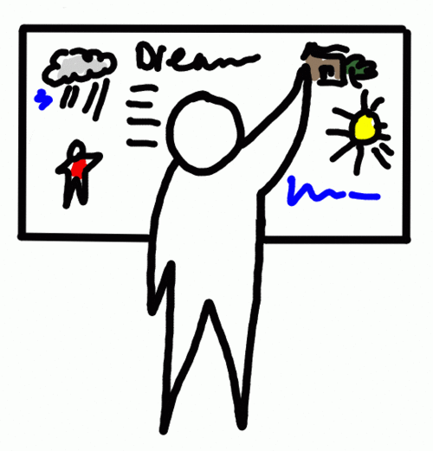

Process
A whole class meeting taken by the EP with the other children but without the target child (about 40 minutes)
Subsequent weekly meetings of a small group, with the target child and with a staff member present to review progress and discuss new strategies (about 15 minutes)
Notes:
‹#›
It is not suitable for all children. Children who are perhaps quiet by nature and who do not stand out in the group and who definitely do not want any attention drawn to them and who do not see themselves as different.
It is designed to share information on and develop empathy for a child who has become isolated.

Slide 6

The whole class meeting
This meeting and the subsequent meetings begins and ends with a game for a few minutes.
Three sheets are prepared
~Fred’s strengths
~Fred’s difficulties
~Circles in our lives

Slide 7
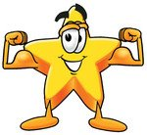
Fred’s strengths
These are elicited from the children and written on a flip chart.
Adults present can prompt the children on suitable responses but they usually have no difficulty in coming up with these e.g. Shares his things, has a good sense of humour, is good at maths
Notes:
‹#›
The children’s parents would already have received a letter and given permission for their child to be included if required. The class teacher would then take the names of the volunteers and compile a list of about 6 to 8 youngsters who are willing to meet. The other volunteers are thanked and are invited to give any ideas they may have to the teacher throughout the week.

Slide 8

Things that Fred find’s difficult
A second list is compiled, again elicited from the children on things that Fred find’s difficult. These are phrased in a suitable way and put onto a flip chart.
The children are reminded that Fred and his parents have given permission and that we are discussing this to help Fred.
Contributions might include, loses his temper, pushes in the line, took my sweets.
Notes:
‹#›

Slide 9
The circles in our lives
Teachers
Child
Minder
Beavers
Lollipop
Lady
Friends
Family
Swim
Club
Notes:
‹#›
We ask the children to think of all the people in their lives. Starting with their family. Then thinking about the outer circle, people who are paid to look after them. The next circle, people who are paid to do something fun with them. And then their friends. How would it be if we had no names to put in the friends section. How might someone feel if they had no friends.?

Slide 10

The psychology bit
It is explained to the children that sometimes, when people are doing things that are hurting other people, it is because they don’t feel so good themselves and they may not feel that they have friends.
It is suggested that maybe some of the things Fred has difficulty with are because he does not feel that he has many friends.
THIS IS THE MOST IMPORTANT PART!
It is important not to rush this part and to create empathy in the class towards the target child.
Notes:
‹#›

Slide 11

Eliciting support
The children are asked to think of ways in which Fred could be helped.
They are then invited to be part of a support group which would meet each week for a short time with Fred and a staff member to see if they can think of ways of supporting Fred and each other.
Notes:
‹#›

Slide 12

The weekly meeting
Game to begin
Target child asked ‘What has gone well’
Other children invited to contribute
All children asked whether there have been any difficulties
All asked to think of any ideas that might help
Suggestions taken ~ all thanked
Game to end
Notes:
‹#›

Slide 13

Safety measures
E D U C A T I O N A L P S Y C H O L O G Y S E R V I C E
Contact with home to ensure that parents are happy with process, and they fully understand what a circle of friends is and that the target child is benefitting throughout
Ensuring that the process has a definite end
Making sure the group are emotionally safe and not taking on too much
Making sure that there is an element of fun.
Notes:
‹#›

Slide 14

Supplementary ideas
E D U C A T I O N A L P S Y C H O L O G Y S E R V I C E
SEAL ~Getting on and falling out section
Befriender systems – older children
Buddy bench
Group buddy system
Lunchtime clubs- structured activities- craft clubs, running a tuck shop.
Safe places/drop-ins during lunch and break times
Notes:
‹#›
Pre requisites
The target child is in need of the strategy and that their need is apparent to the children. That this child has the cognitive and emotional skills to make use of the strategy.
That the children are old enough to reflect on their own and other children’s behaviours.
That they are likely to remember the issues discussed and the strategies discussed.
Parents and the child in question understand the process and have given permission.
The target child’s behaviour is such that they are standing out in the group and it is obvious to the class that the child has difficulty.
The targe
The target child and their parents want the process to take place and fully understand the process. They need to have been given written information on the whole process and in particular know that their child’s and their child’s behaviour will be discussed openly with the child’s classmates without the child being present.
We have sample letters that can go out to parents and information. A meeting with the parents of the target child would be set up to explain the process and answer questions etc.
This is an unusual strategy and for this reason it would only be undertaken if the child’s behaviour was such that they are standing out in the peer group and becoming isolated as a result of their behaivour.

Slide 15

Evaluating progress
E D U C A T I O N A L P S Y C H O L O G Y S E R V I C E
Comments from the group, child, class teacher and/or child’s parents
Sociograms
Questionnaires
Notes:
‹#›

Slide 16

Psychological Theory
Maslow’s hierarchy of needs
Humanistic psychology
Dodge’s model of social interaction
Social learning theory

Slide 17

Any questions?
Notes:
‹#›

